Slide 1
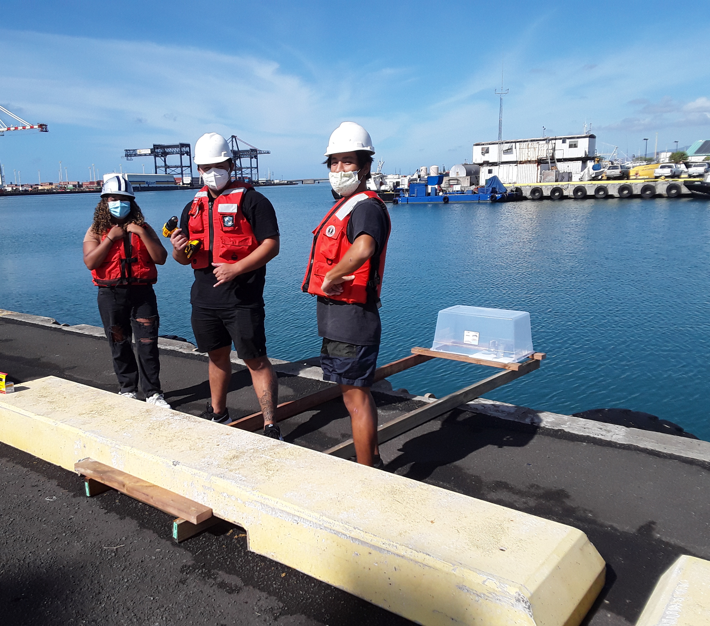
Open Water Level
Initial Challenge:
Design a ~ $100 open-source, easy-to-reproduce water level sensor for high school science classes and field trips
Photo Credit: Ellen Briggs, UHM

Slide 2
Open Water Level
Teaches:
Basic wiring
Basic coding
Soldering
Water level/tides
Analog signals
QA/QC

Slide 3
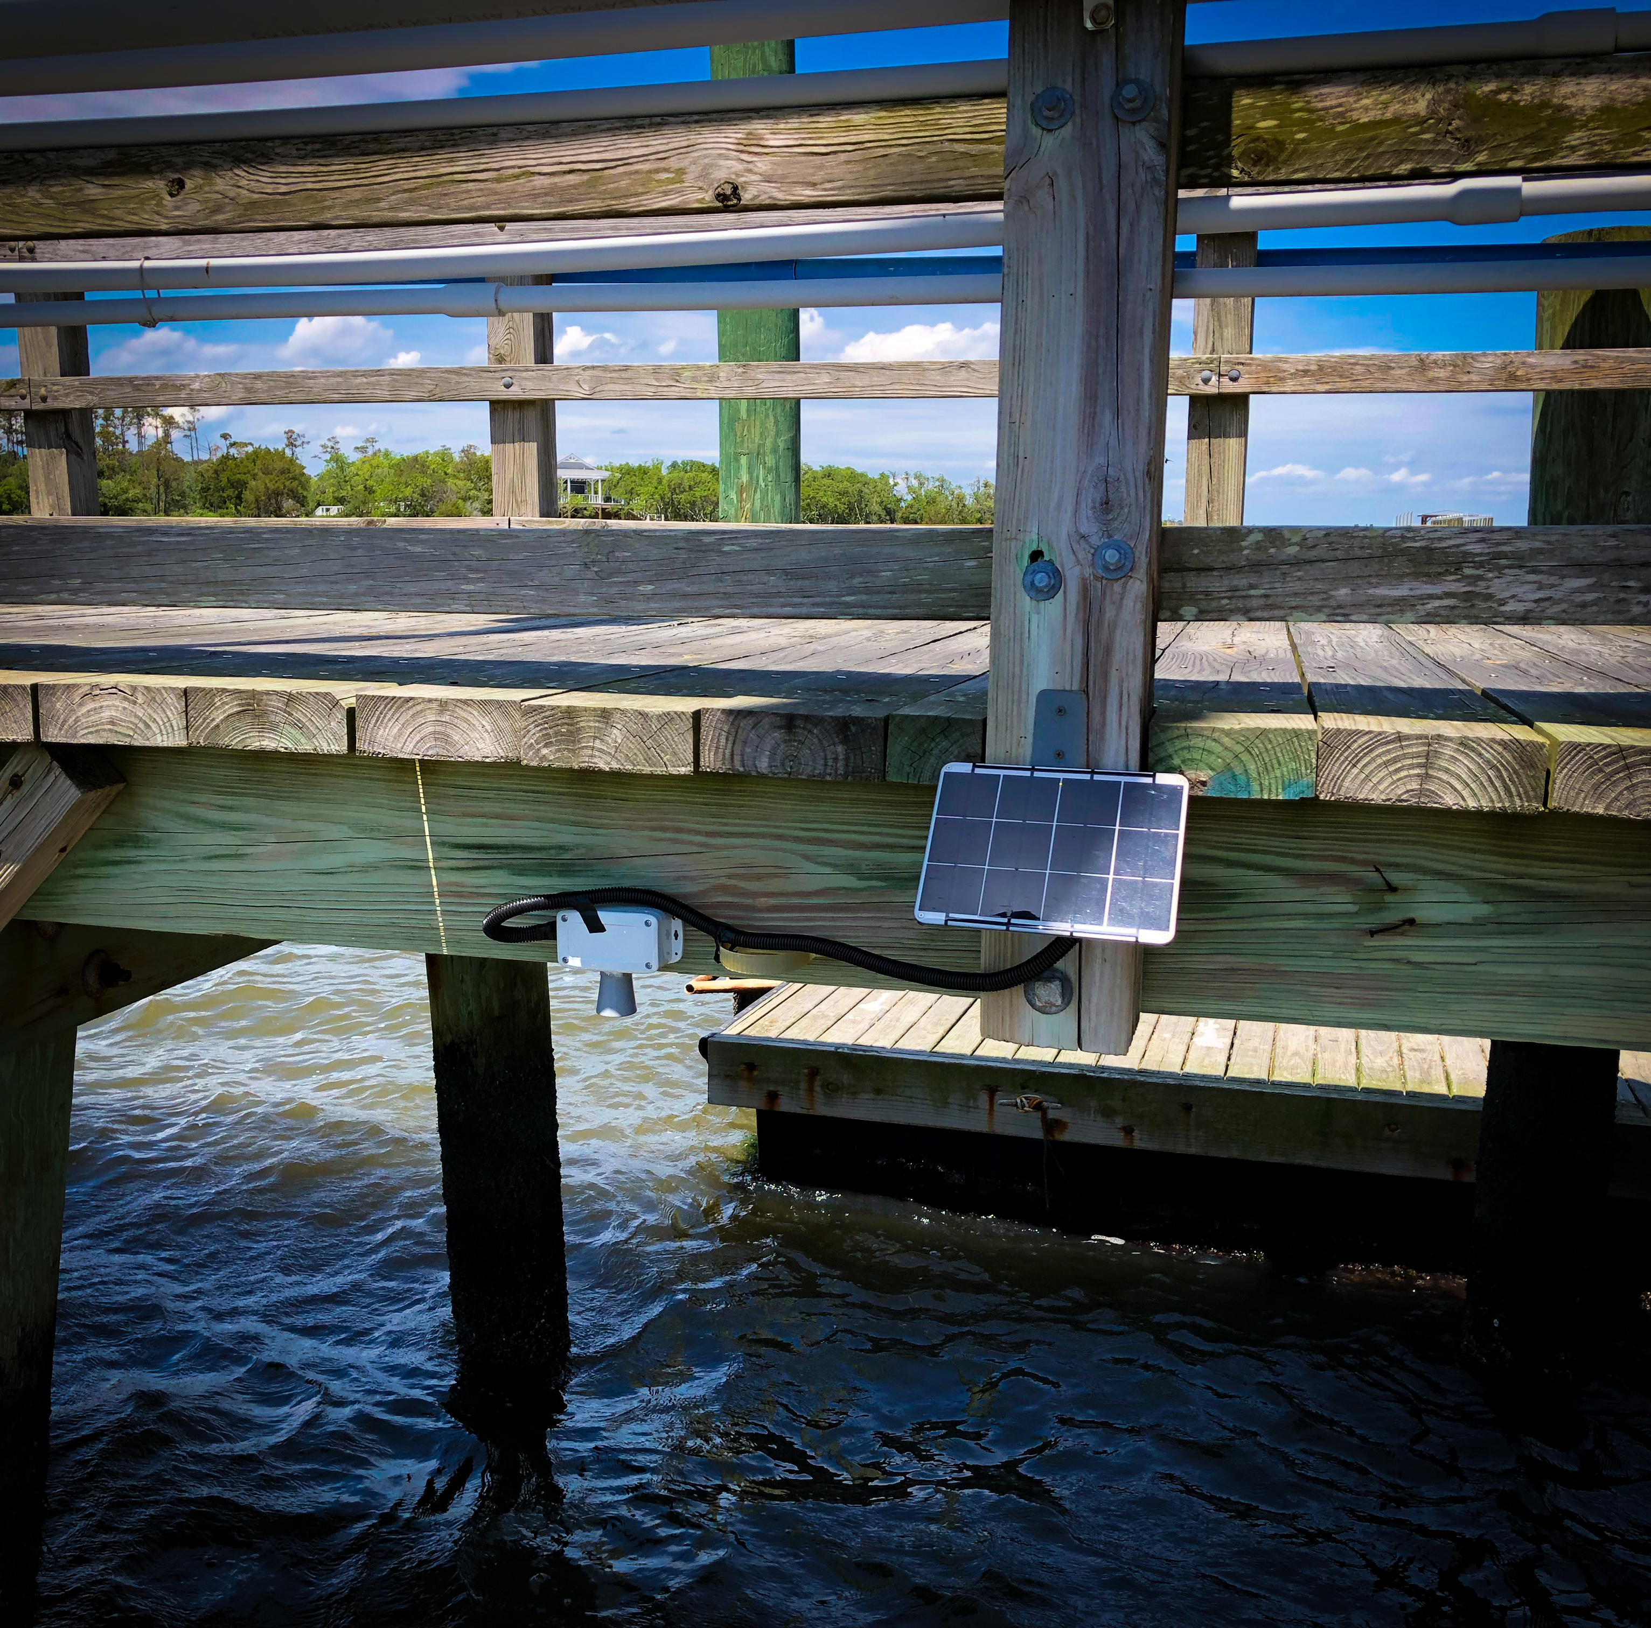
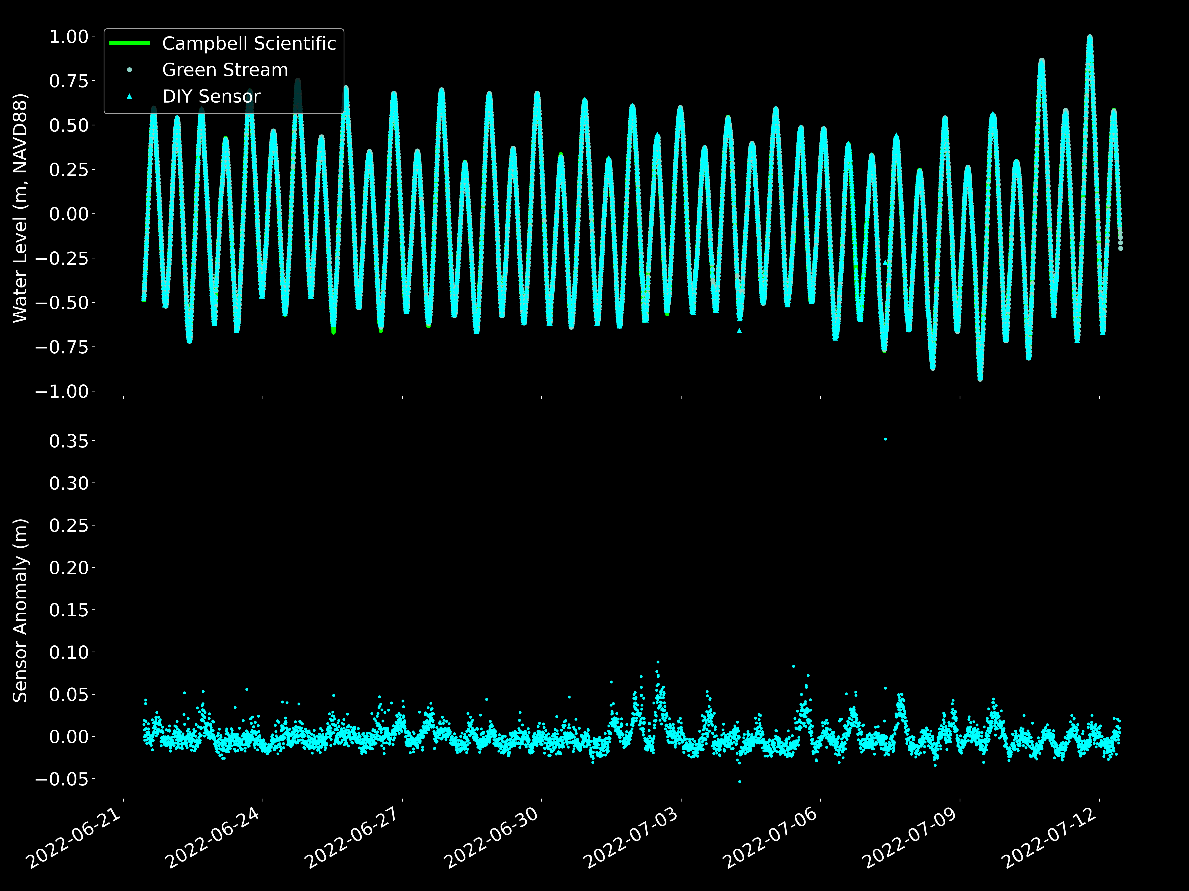
Proof-of-Concept:
Our low-cost sensor has results almost indistinguishable from more expensive, commercial versions
Error: < 1.5 cm and still improving
Sufficient for flood detection, tide monitoring, education, etc.
Notes:
NB: remake top fig, invert colors

Slide 4
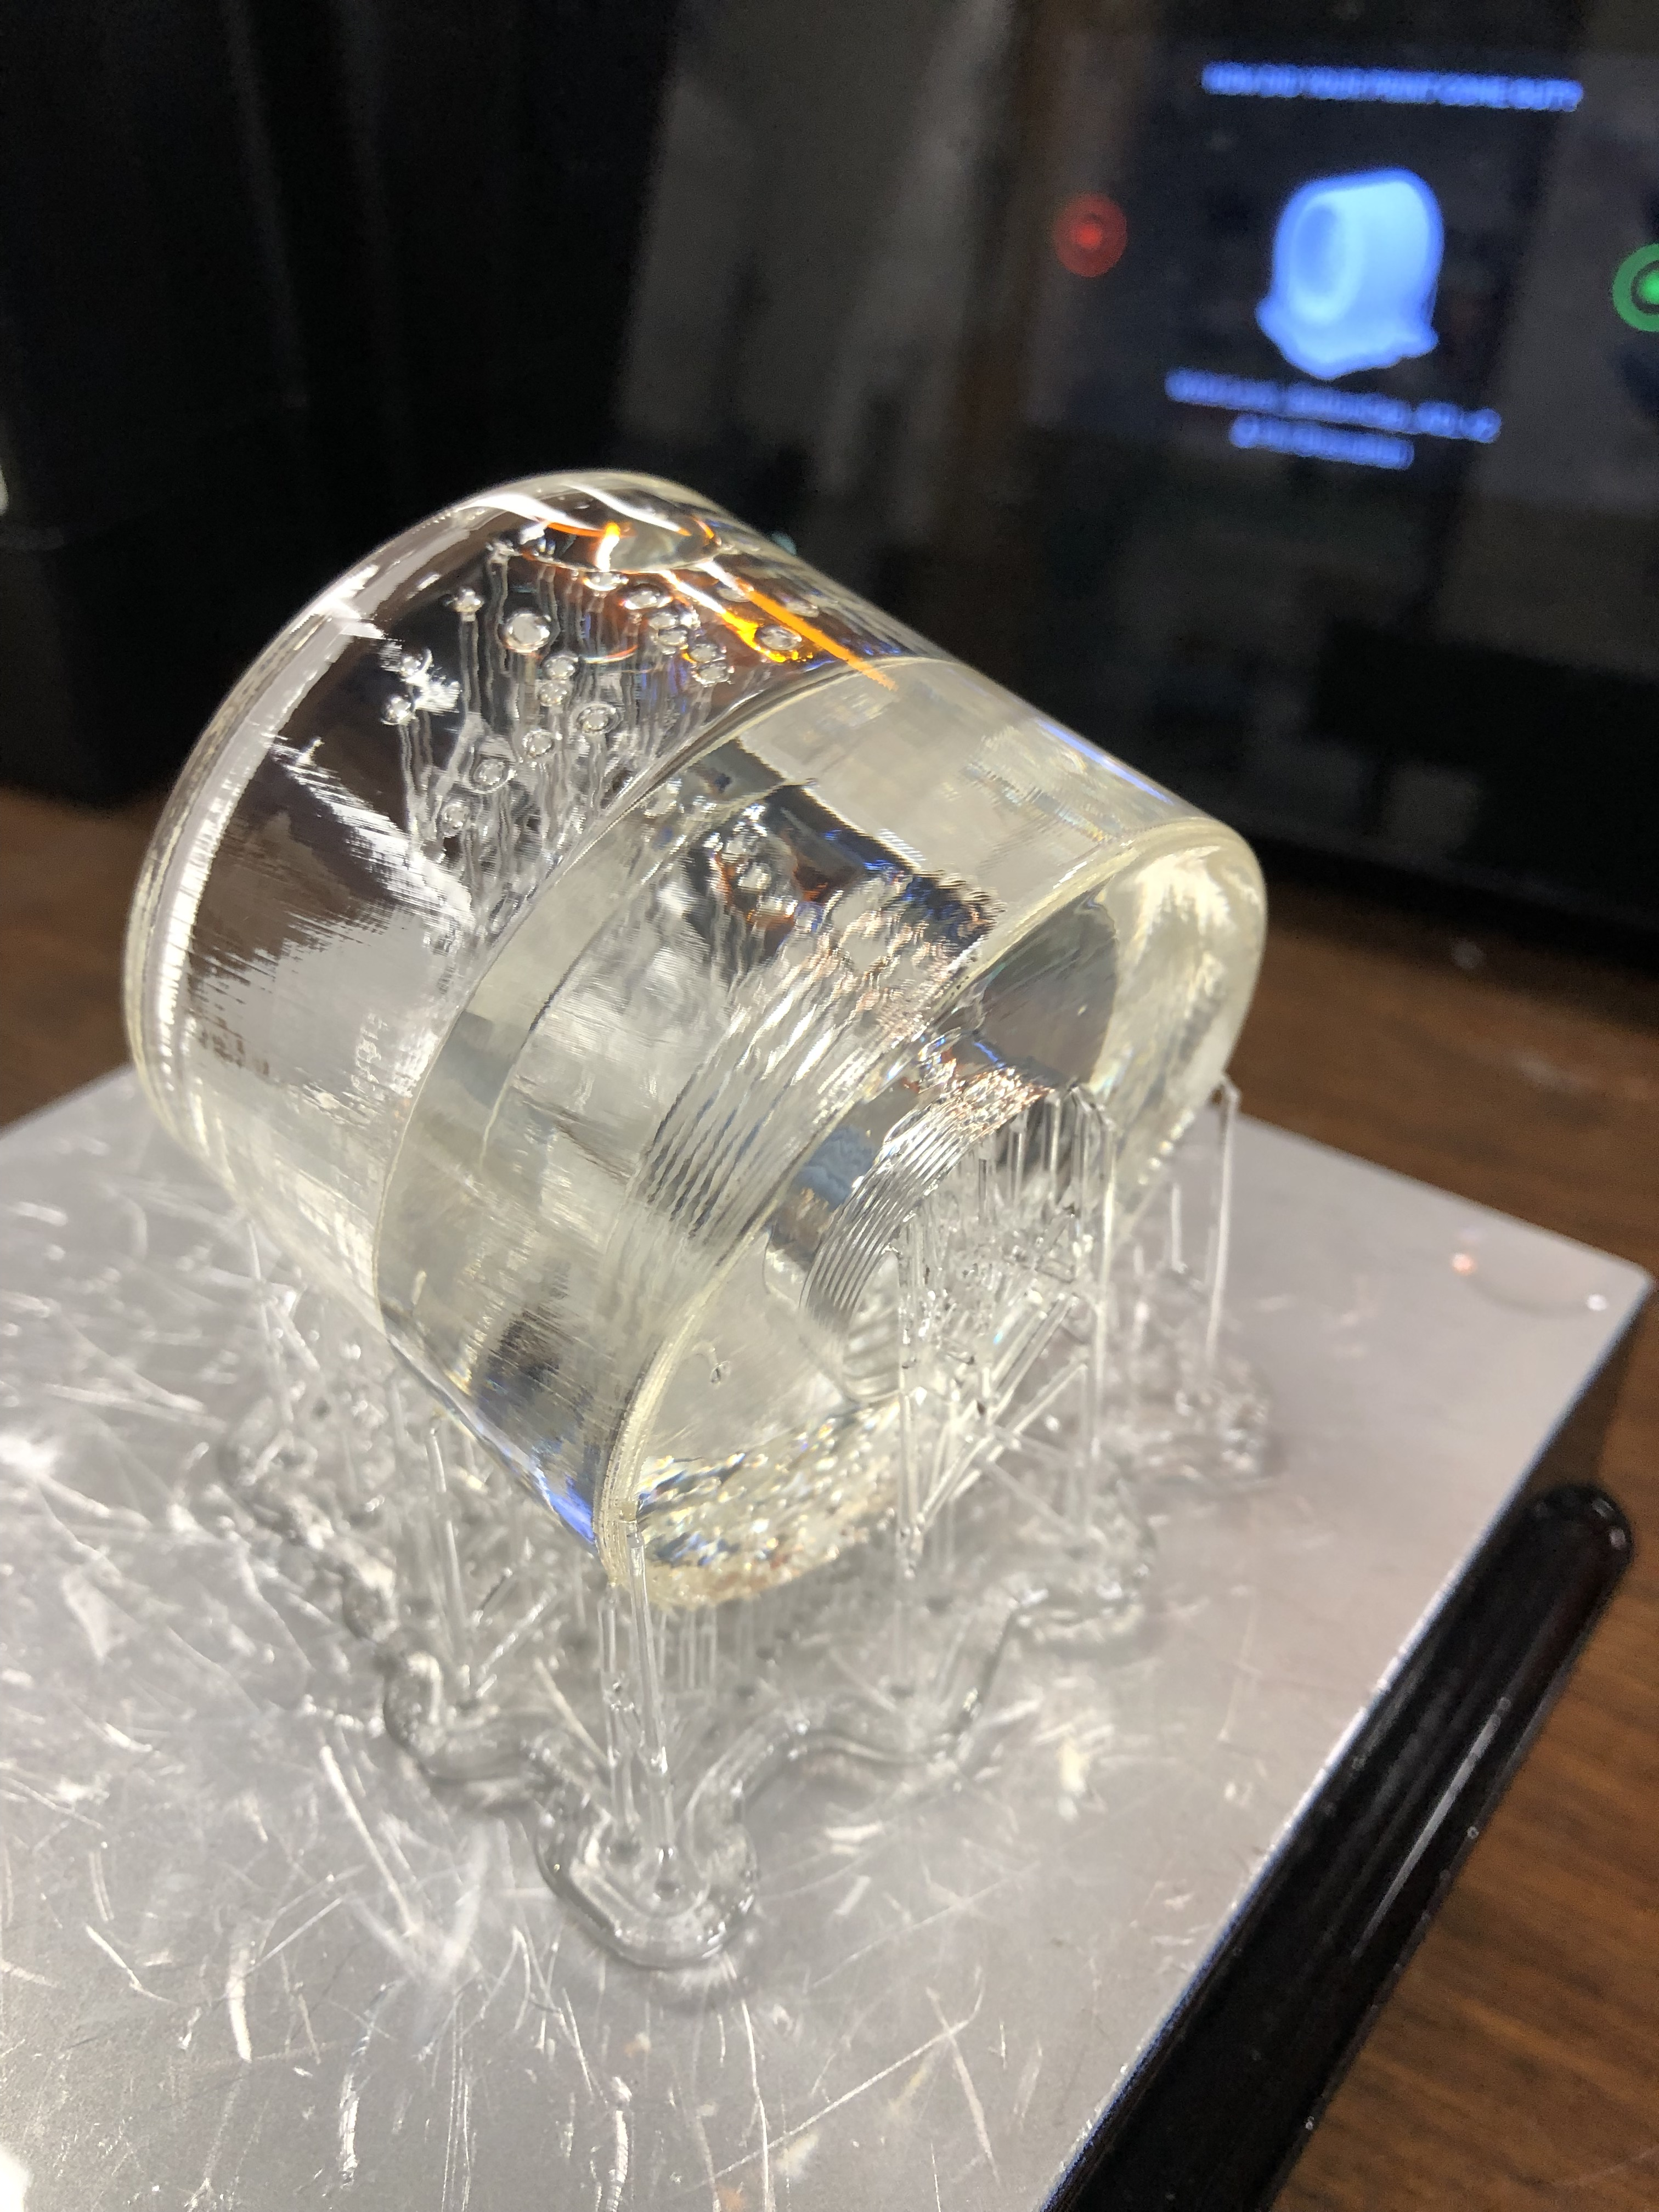
Ongoing Research:
3D printing custom components (easy to reproduce/fabricate)
Adding cellular connectivity, CORMP.org for data visualization/management
Two sensors to be deployed on Smith Creek imminently
With Principal Investigators Monica Rother and Andrea Hawkes, student Kendra Devereux
Examine inundation and saltwater intrusion upstream of Cape Fear River/dredging
Notes:
NB: remake top fig, invert colors

Slide 5
Want to get involved?
(IMPORTANT! We do not yet have a designated volunteer program. We appreciate any interest, but any volunteer would be a bit of a guinea pig.)
With ~ $300 and legal, safe access to a fixed dock structure to which you could mount a sensor, we could explore the potential of collaborating on the deployment of the cell-enabled, real-time device
Write to bresnahanp@uncw.edu to learn more

